Slide 1
ANALYSIS FOR Real-Estate
MENU
ANALYSIS
CONTACT
Data Science
DATA
Current - Future

Slide 2

OUR TEAM
Osama Magdy
Reem Emad
Yousef Gamal
Ziad Atef
MENU
ANALYSIS
CONTACT
Data ANALYSIS

Slide 3
TABLE OF CONTENT
Company policies
Process speeding up
01
02
Future flags
03
MENU
ANALYSIS
CONTACT
Data ANALYSIS

Slide 4
Company Policies
MENU
ANALYSIS
CONTACT
Data ANALYSIS
Revising issues with our company policies & priorities
Communicate new policies to agents

Slide 5
What we will do?
MENU
ANALYSIS
CONTACT
Sale price
01
02
Kitchen quality
What do we need to focus on?
How much is it important?
Position
04
03
Style of dwelling
Does the proximity to various conditions affect average sale price?
How much is it important?
Pool?
05
06
Lot Shape
Is it really significant?
Before development what about the land?

Slide 6
Price
DATA ANALYSIS
01
MENU
ANALYSIS
CONTACT
Data ANALYSIS
Sale
Let’s Start

Slide 7
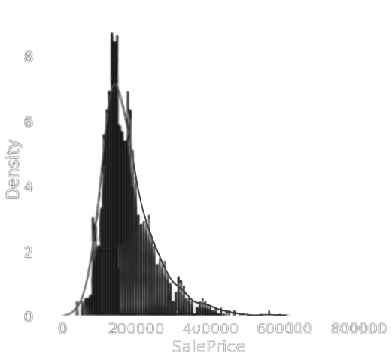
How does it look?
MENU
ANALYSIS
CONTACT
Data ANALYSIS

Slide 8
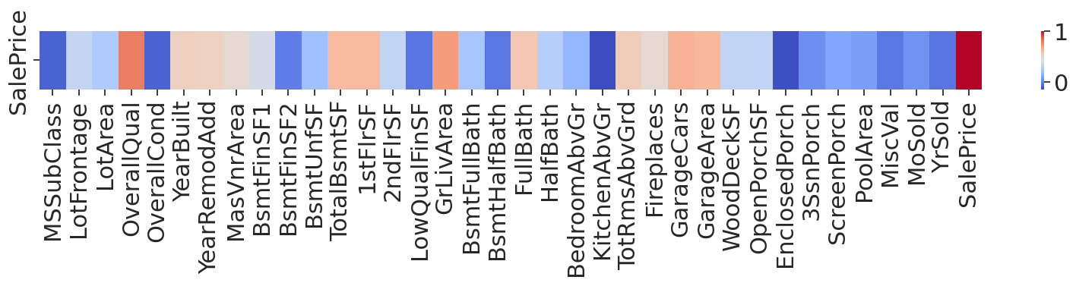
What to look for?
MENU
ANALYSIS
CONTACT
Data ANALYSIS
After Correlation analysis it was found that the following three are mostly correlated with the sale price
Overall house quality: 0.790982
Size of garage in car capacity: 0.708624
Above grade (ground) living area square feet: 0.640409

Slide 9
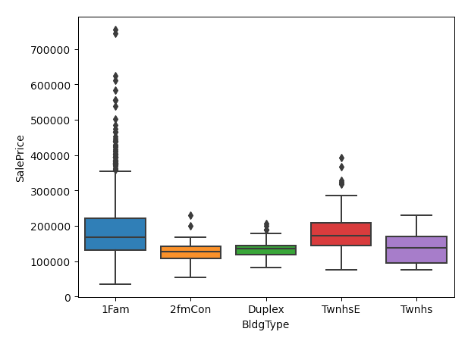
Is kitchen that important?
Style of Dwelling?
MENU
ANALYSIS
CONTACT
Data ANALYSIS
Upon correlation analysis between kitchen quality and sale price:
correlation coefficient is: 0.660
Statistical significance: 5.051357364029292e-183

Slide 10
DESCRIPTIVE ANALYSIS
Pool
various conditions
lot shape
MENU
ANALYSIS
CONTACT
Data ANALYSIS
After comparing means and using statistical tests it was found that
T- statistic=1.3827
p-value=0.216
Various conditions affect average sale price
T- statistic=1.3827
p-value=0.21
Various lot shapes affect average sale price
F-statistic: 40.13285166
P-value: 6.44752385e-25

Slide 11
DIAGNOSTIC ANALYTICS Resulta
MENU
ANALYSIS
CONTACT
Data ANALYSIS
More Focus
Neglect
Update policies to provide more care about Overall house quality, Size of garage in car capacity, Above grade (ground) living area square feet
Neglect houses with pools as it doesn’t influence price
Renovations
Acquisition
Renovation for kitchen quality is no necessary.
Position and lot shape has a noticeable importance when buying lots

Slide 12
Process Speed-up
MENU
ANALYSIS
CONTACT
Data ANALYSIS

Slide 13
—Forbes
—National Association of Realtors
MENU
ANALYSIS
CONTACT
Data ANALYSIS
“Speed Is The Most Important Thing For Your Business’ Profitability”
“homes that sold within the first month of being listed typically sold for closer to their asking price than those that remained on the market for longer periods of time.

Slide 14
Tools to be provided
Price Estimator
Search Localizer
MENU
ANALYSIS
CONTACT
Data ANALYSIS
Model that estimate the price to provide 2 values:
Provide and assist users
Predict renovations
VS
A tool that narrows the search area depending on user requirements

Slide 15
Price Estimation results
RF
CB
XGB
LGBM
MENU
ANALYSIS
CONTACT
Data ANALYSIS
Mean absolute error: 17920.640694444446
Mean squared error: 31310.259699604107
Mean absolute error: 17186.577738562894
Mean squared error: 26418.390414036377
Mean absolute error: 16279.227573091057
Mean squared error: 25567.8824729713
Mean absolute error: 15638.595913725061
Mean squared error: 23855.516144771584

Slide 16
Search Localizer results
RF
SVM
NB
MENU
ANALYSIS
CONTACT
Data ANALYSIS
Accuracy score: 0.10136986301369863
Accuracy: 0.3315068493150685
Accuracy: 0.6767123287671233

Slide 17

Plans
What is needed?
MENU
ANALYSIS
CONTACT
Data ANALYSIS
Future

Slide 18
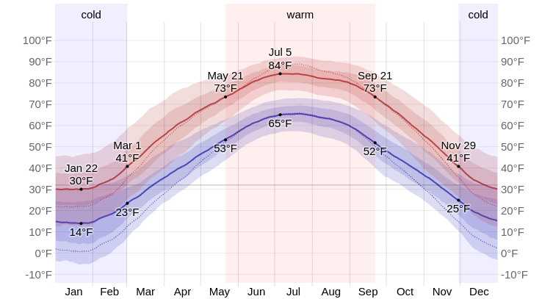
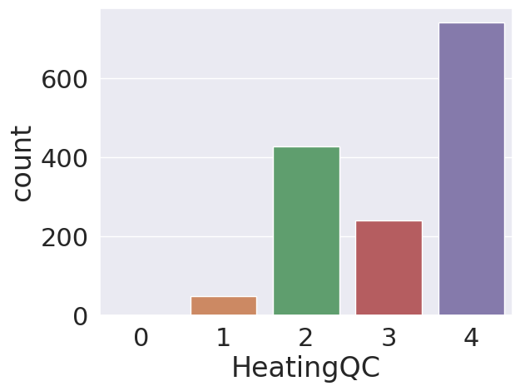
Why?
MENU
ANALYSIS
CONTACT
Data ANALYSIS
Due to the nature of weather in ames that is displayed in the illustration
Due to the climate changes which lead to weather worsening more

Slide 19
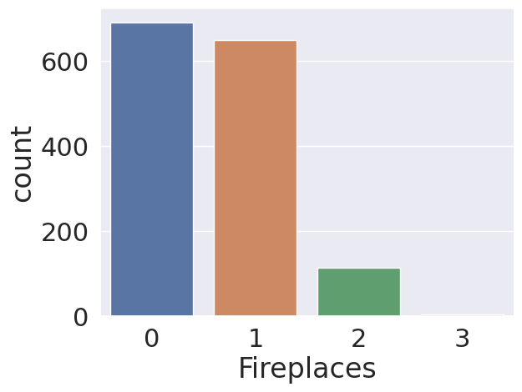
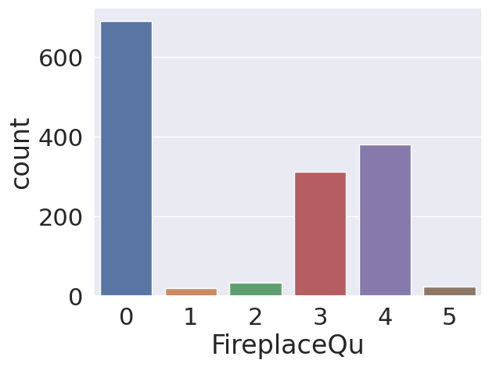
Independents overview
MENU
ANALYSIS
CONTACT
Data ANALYSIS

Slide 20
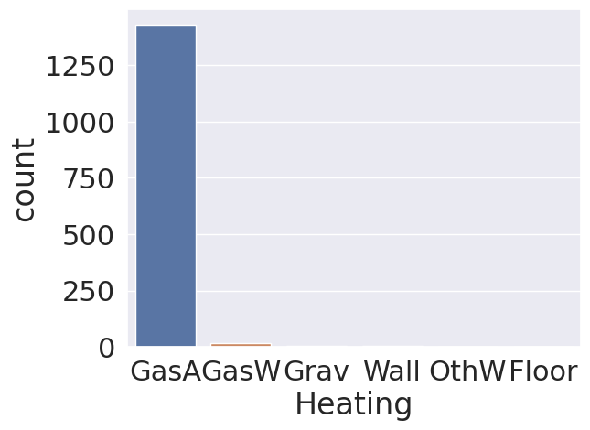
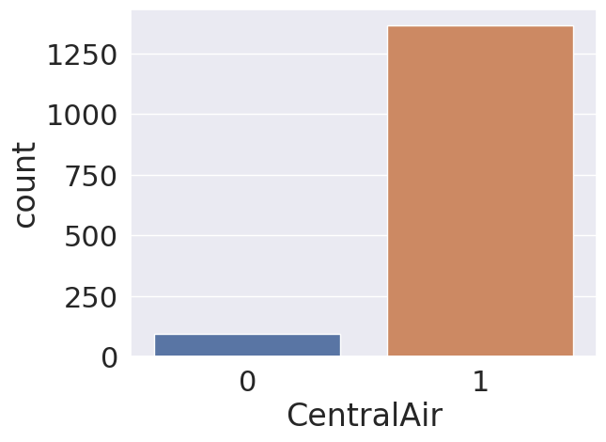
Independents overview
MENU
ANALYSIS
CONTACT
Data ANALYSIS

Slide 21
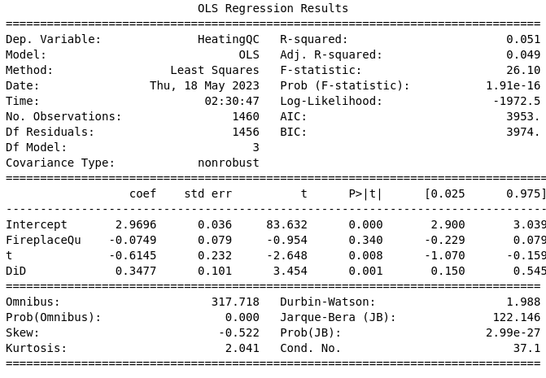
Vs Fireplace Quality
MENU
ANALYSIS
CONTACT
Data ANALYSIS
Mean of HeatingQC for FireplacesQu <= 2: 2.961
Mean of HeatingQC for FireplacesQu > 2: 3.336
Difference in Differences: 0.3477
Then yes there is a causality but not significant.

Slide 22
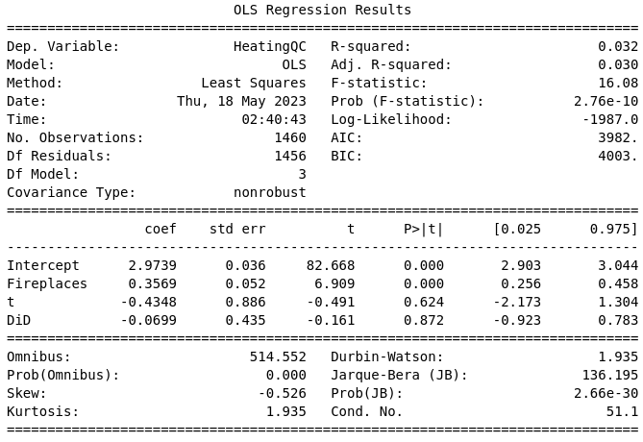
Vs Fireplace Count
MENU
ANALYSIS
CONTACT
Data ANALYSIS
Mean of HeatingQC for Fireplaces <= 1: 3.147
Mean of HeatingQC for Fireplaces > 1: 3.125
Difference in Differences: -0.06989967

Slide 23
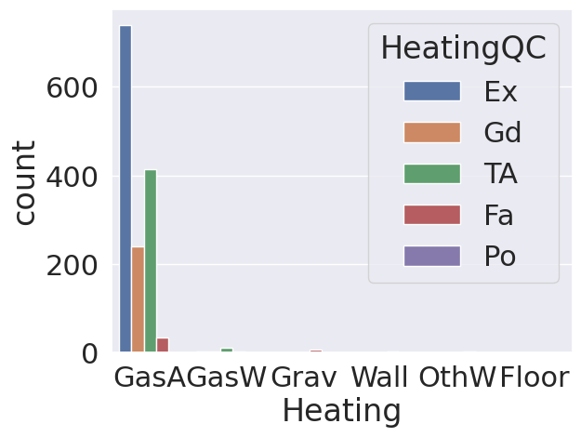
Answer?
MENU
ANALYSIS
CONTACT
Data ANALYSIS

Slide 24
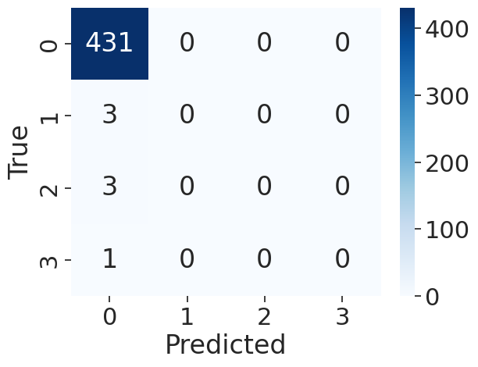
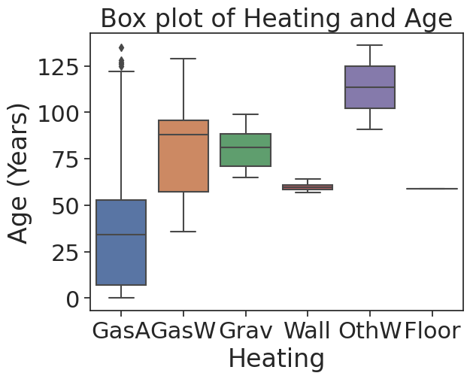
SO Can we predict Heating?
MENU
ANALYSIS
CONTACT
Data ANALYSIS

Slide 25
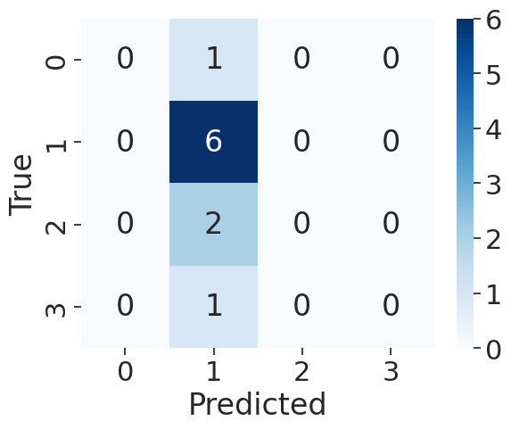
Okay Just remove it!!
MENU
ANALYSIS
CONTACT
Data ANALYSIS

Slide 26
THANKS!
MENU
ANALYSIS
CONTACT
Data ANALYSIS
Do you have any questions?
Please keep this slide for attribution

